Slide 1
Microsoft Azure IaaS Part 2
한국마이크로소프트
기업고객사업부

Slide 2
Differences from on-premises

Slide 3
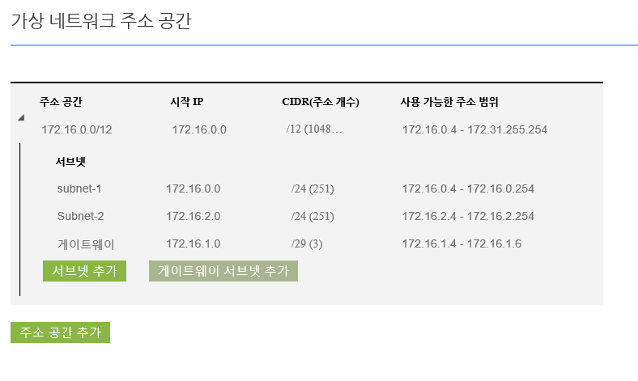
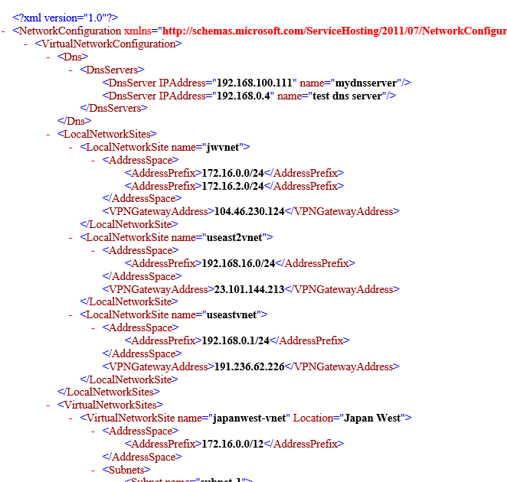
Virtual Network 생성, 변경, 및 IP 영역
Virtual Network가 필요한 경우
다른 네트워크(Cross-Premises)와 통신이 필요한 경우
VM간에 직접 통신이 필요할 경우
독립적인 Name Resolution(DNS)가 필요한 경우
VM에 고정 사설 IP를 부여해야 할 경우
Virtual Network 생성 방법
Azure Portal 사용
Network configuration 파일 사용
Virtual Network에 사용 불가능 IP 영역
224.0.0.0/4 (Multicast)
255.255.255.255/32 (Broadcast)
127.0.0.0/8 (loopback)
169.254.0.0/16 (link-local)
68.63.129.16/32 (Internal DNS)
가상네트워크의 서브넷수 제한 없음
서브넷의 최소 /29, 최대 /8
각 서브넷의 최초 3개 IP는 Azure에서 예약
지원 프로토콜 – TCP, UDP, ICMP
멀티캐스트, 브로드캐스트, IP encapsulation, GRE 미지원
서브넷간의 라우팅 변경, Tracert 및 라우터 ping 미지원

Slide 4
Azure DHCP & Azure DNS
Azure DHCP
모든 Azure 상의 VM은 DHCP 구성으로 NIC가 설정 됨
VM내에서 static으로 구성할 경우, 네트워크 연결이 손실될 수 있음
DHCP 기능을 실행하는 VM을 실행할 수 없음
Azure DNS
Azure가 제공하는 DNS를 사용하거나 별도의 DNS를 사용할 수 있음
최대 12개의 DNS를 설정할 수 있음(DNS는 순서대로 사용됨, no round-robin)
DNS 설정을 바꾸면 VM이 재시작되어야 DNS설정이 업데이트 됨
자체 Azure DNS의 기능
추가 구성 작업 없음
동일 Virtual Network내에 동일 Cloud Service간의 Name Resolution 지원
동일 Virtual Network내에 다른 Cloud Service간의 FQDN으로 Name Resolution 지원
호스트 이름 변경 지원
동일 VM에 복수개의 호스트이름 미지원
Azure에서 자동으로 생성한 DNS suffix 변경 미지원
임의 레코드 생성 불가
최대 100개 Cloud Service 지원

Slide 5
VIP, DIP, ILPIP
IP address type | Virtual IP | Dedicated IP | Instance-level Public IP
Description | Public IP addresses shared between multiple VMs | Private IP address assigned to each VM from the virtual subnet | Public IP dedicated to a single VM
Dynamic | By default | By default | By default
Can be static | Yes | Yes (by DHCP) | No
FQDN | Assigned for public usage | Assigned for private usage | Optional for public usage
NAT required | Yes | N/A | No

Slide 6
Allocated or Deallocated
VM Status | Stopped(Deallocated) | Stopped
Description | When stopped via portal | When stopped inside a VM Or stopped with an option in PowerShell cmdlet, Stop-AzureVM -StayProvisioned
Cost | Not charged against Compute, but charged for Storage of VHD | Charged for Compute and Storage
Temp disk | Lost | Maintained
Start speed | Slow (almost the same time when deployed first ) | Fast within a minute
VIP address | Lost if not reserved and there is no more VM under the same Cloud Service | Maintained

Slide 7
Custom VM Image

Slide 8
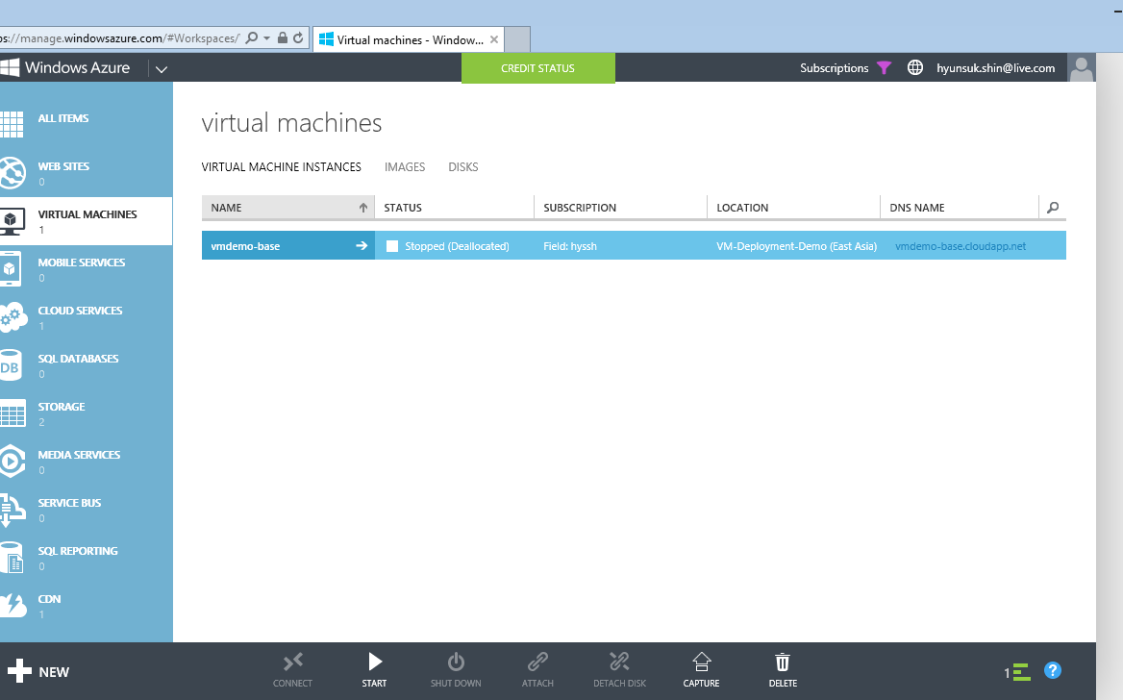
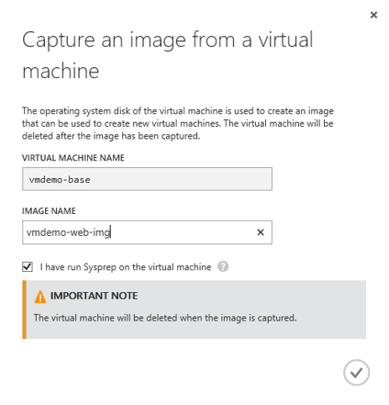
VM – Custom VM Image
Three options in creating your own VM from your customized
Image
can capture a VM you configured on Azure
VHD is copied when a VM is created
can contain multiple VHDs
Generalized or specialized
Disk
Creating a VM from export and import a VM configuration
VHD is not copied
Uploading
You can upload your VHD you configured on a local Hyper-V
https://azure.microsoft.com/ko-kr/documentation/articles/virtual-machines-linux-create-upload-vhd-ubuntu/
VM Capture

Slide 9
VM Backup

Slide 10
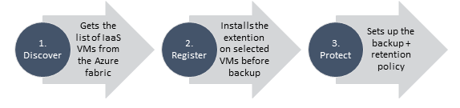
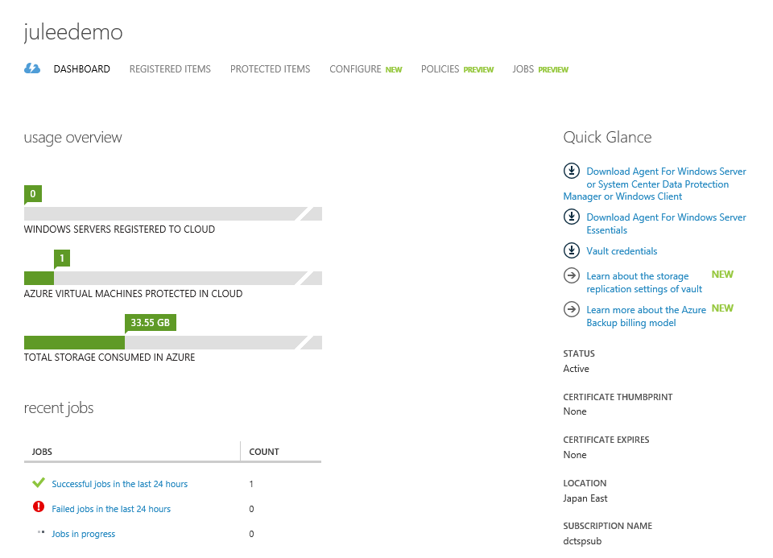
VM – Backup
Azure VM can be backed up and recovered at any point you want
Application-consistent backup of virtual machines
No shut down of VM required
Application level consistency for Windows OSes
File system level consistency for Linux OSes
Fabric level backup
Agentless backup of multiple VMs at the same time
Single, central management interface through the Azure portal
Detailed Jobs view for tracking progress and success/failure
Policy-driven backup and retention
Configuration of scheduled backup
On-demand backup
Retain backup data in Azure Backup vault even if the original VM is deleted
Backup frequency: daily, weekly or manual (for preview)
Retention range: 4 weeks max (for preview)
Storage
Locally or geo redundant

Slide 11


Azure IaaS VM backup
Azure Backup Vault
Azure IaaS VM
R3 | 1 | 2 | 3 | 4
Recovery Points
R2 | 1 | 2 | 3 | 4
R1 | 1 | 2 | 3 | 4
Snapshots
Production
…
1
3
3
1
2
3
4
Data Blocks
Value Proposition:
Incremental Backup
Performant Storage

Slide 12
Azure Site Recovery

Slide 13

Orchestrated Disaster Recovery
Between on-premises and/or service provider locations
Microsoft Azure Site Recovery
Communication Channel
Replication channel: Hyper-V Replica
Windows Server
Primary Site
Recovery Site
Windows Server

Slide 14
Orchestrated Disaster Recovery
for Hyper-V VMs, between on-premises locations
& Microsoft Azure
Microsoft Azure Site Recovery
Microsoft Azure Site Recovery
Communication Channel
Communication and Replication
Replication channel: Hyper-V Replica
Windows Server
Primary Site
Recovery Site
Windows Server
Primary Site
Windows Server
Key features include:
Automated VM protection and replication
Remote health monitoring
Customizable recovery plans
No-impact recovery plan testing
Orchestrated recovery when needed

Slide 15
Heterogeneous Disaster Recovery
for VMware vSphere-based VMs & Physical Servers with InMage Scout
Microsoft Azure Site Recovery
Download InMage Scout
Replication channel: InMage Scout
VMware/Physical
Primary Site
Recovery Site
VMware/Physical
InMage Scout
OS-based replication for flexibility
Supports VMware vSphere & Physical Servers as the source of replication
Supports VMware vSphere as target for replication & recovery
Ideal for enterprises & service providers with existing VMware investments

Slide 16


Migration scenarios
Virtual or Physical machine to Azure
Source: On-premise
Target: Microsoft Azure
AWS VM to Azure
Source: AWS
Target: Microsoft Azure
Azure to Azure
Source: Microsoft Azure
Target: Microsoft Azure

Slide 17
Azure Migration Roadmap, Futures, and North Star
Regions
Azure is in 19 regions today with more on the way. India private preview program for 3 new regions expected to open this year
Guidance
Best Practice documentation for Azure to Azure migration including born-in-cloud native multi-tier applications
Tooling
ASR preview (2015): more Sources and guest OS types.
Consistent experience (Roadmap): On-premise to Azure migration has a lot of overlap with Azure to Azure. Consider one solution/approach for both which includes all workloads.
Migration-as-a-Service (North Star): migration is just a service you just click a button in the UI without managing the migration service
Source | Availability | Supported Guest OS Types
Hyper-V 2012 R2 | Available | All Guest OS types supported by Azure
Hyper-V 2008 R2 SP1 and 2012 | Available | Windows and Linux
VMware vCenter Server 5.1/5.5, ESXi 5.1/5.5, Physical Machines, Azure VMs | Available | Windows and Linux
Amazon Web Services (Windows AMIs) | Available | Windows Server 2008 R2 SP1+
Amazon Web Services (Linux AMIs) | Roadmap | TBD
Remove pain points for migration in Azure (North Star): investigate Azure platform improvements such as renaming storage accounts so applications don’t need to change endpoints

Slide 18
Network Security

Slide 19
Layered Security, Protection, and Isolation
VM Firewall
Cloud Service
ACL/NSG
VNet
DDoS Protection

Slide 20
DDoS System Overview
Supported DDoS Attack Profiles
TCP SYN
UPD/ICMP/TCP Flood
Detection Process
Traffic to a given /32 VIP Inbound or Outbound is tracked, recorded, and analyzed in real time to determine attack behavior
Mitigation Process
Traffic is re-routed to scrubbers via dynamic BGP routing updates
Traffic is SYN auth. and rate limited
Mitigation Capacity
460 - 650Gbps protection available per region
Capacity across regions can be pooled for >7Tbps protection
Internet
MSFT Routing Layer
Routing Updates
Flow Data
Profile DB
Detection Pipeline
Attack Traffic
Scrubbed Traffic
Scrubbing Array
SLB
Application

Slide 21
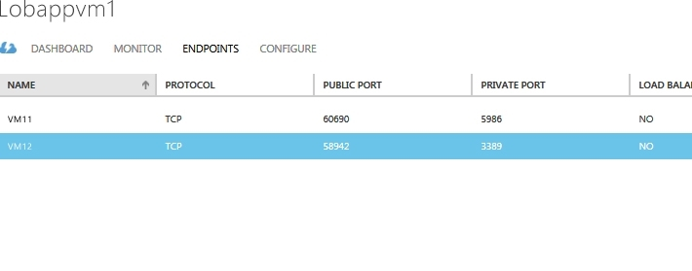
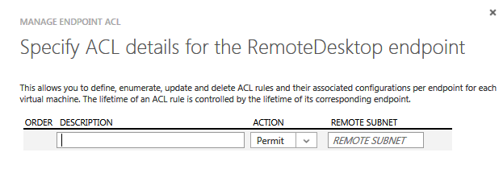
Public Endpoint Access Control Lists (Non VNet)
End Point ACL
Virtual Machines
P
IP: 127.255. ---.---
IP: 127.255. ---.---
IP: 111.111. ---.---
P
IP: 101. 121.---.255
IP: 101. 121.---.255
IP: 2001:4898:9:2:---:e60c:b118:---

Slide 22




DMZ in the Cloud
Internet
Grouping of Network traffic rules as security group
Security groups associated with Virtual machines or virtual subnets
Controlled access between machines in subnets
Controlled access to and from Internet
Network traffic rules updated independent Virtual machines
Microsoft Azure
NSG
FrontEnd Subnet
BackEnd Subnet
NSG
Virtual Network

Slide 23
Network Security Group
Full 5 tuple based Access control rules
Prioritized set of rules
Default Tags for Virtual Network, Internet
CIDR for Source and Destination IP ranges
A single port or port range
Applies to Internal and External traffic
Applied at the VM and/or Subnet
VM1
VM2
NSG 1
Pri | Access | Src | Port | Dst | Port | Protocol
Virtual Subnet
NSG 2
Pri | Access | Src | Port | Dst | Port | Protocol

Slide 24
Virtual Network Gateway

Slide 25
IPSEC - S2S
Azure에 구성된 Virtual Network간 또는 외부 네트워크 간에 S2S IPSEC VPN 지원
Juniper, Cisco, Windows Server등 다양한 VPN 장비 지원
지원 장비 목록: http://msdn.microsoft.com/library/azure/jj156075.aspx
서로 연결되는 Virtual Network 또는 On-premises network은 IP 영역이 중첩될 수 없음
Multi-site VPN 연결은 Azure Portal에서 지원되지 않음 http://msdn.microsoft.com/en-us/library/dn690124.aspx
No encryption 지원: Azure virtual network간의 통신은 Microsoft 데이터센터 자체 네트워크를 사용하므로 더 빠른 성능을 위해 No encryption 사용 가능
Gateway 성능
Gateway SKU 변경
Hub and Spoke
Daisy Chain
Gateway SKU | S2S VPN Throughput | 최대 S2S 터널 개수
기본 | ~100Mbps | 10
고성능 | ~200Mbps | 30
PS D:\> Resize-AzureVNetGateway –VNetName MyAzureVNet –GatewaySKU HighPerformance
PS D:\> Resize-AzureVNetGateway –VNetName MyAzureVNet –GatewaySKU Default

Slide 26
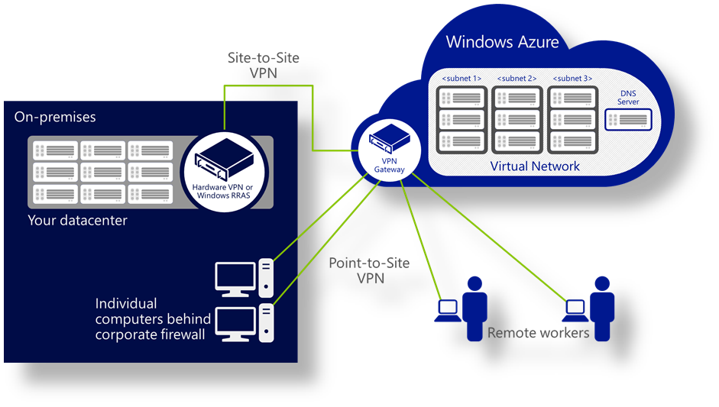
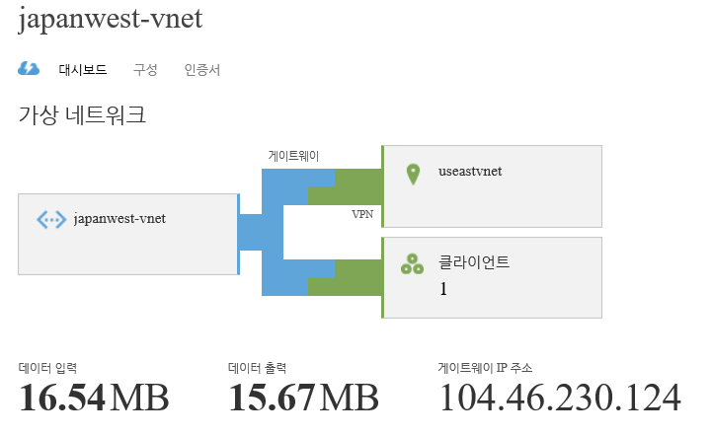
IPSEC - P2S
Azure에 구성된 Virtual Network에 클라이언트로 접속하여 서비스 활용
Virtual network당 최대 128개의 클라이언트 지원
HTTPS 기반의 SSTP 사용하여 Firewall이나 Proxy를 통과하기 용이함
Self-signed 인증서 기반 인증 사용
S2S와 P2S 동시 사용 가능, 다수 Virtual Network에 동시 P2S 가능
지원 Client 운영 체제
Windows 7 (32-bit and 64-bit)
Windows Server 2008 R2 (64-bit only)
Windows 8 (32-bit and 64-bit)
Windows 8.1 (32-bit and 64-bit)
Windows Server 2012 (64-bit only)
Windows Server 2012 R2 (64-bit only)
구성 방법
Azure Portal에서 Virtual Network 및 동적 라우팅 게이트웨이 생성
Self-signed root 인증서를 생성하여 Azure Portal에 업로드
필요한 사용자에게 클라이언트 인증서 생성 및 배포
VPN 클라이언트 설치 및 연결
<http://msdn.microsoft.com/en-us/library/dn133792.aspx>

Slide 27
Network Virtual Appliances

Slide 28
Customer requirements
Similar network capabilities, policy enforcement and middle boxes as their on-premises networks
Application level security: inbound web traffic and blocks SQL injections, Cross-Site Scripting, malware uploads & application DDoS…
Caching, compression
Security / inspection checkpoints (e.g. Intrusion Prevention)

Slide 29
DMZ Scenario with an Appliance
Application
Azure Load Balancer
Internet
NSG
Azure Load Balancer
Any
Azure Load Balancer
NSG
80/443
Web Servers
WAF Appliances
NSG
1443
Database
Azure Load Balancer

Slide 30
Networking investments to support NVA
IP Routing and Forwarding: custom routes, bump in the wire
User defined routes: customer defines routing policy
Multiple VIPs: needed for shared services like L7 load balancers
Multiple CA’s per NIC: provides isolation
Multiple NICs: Separate frontend-backend traffic, and management-data planes

Slide 31
VM Agent & Extension

Slide 32
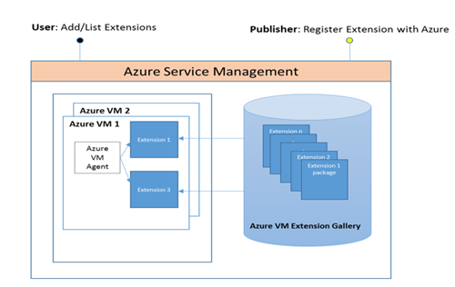
VM Agent (Pre-requisite)
Announced on Thursday, February 20, 2014
A light weight process intended to bootstrap additional solutions, offered both by Microsoft and partners, for configuring, managing, and accelerating Virtual Machines.
VM Extensions (Get-AzureVMAvailableExtension)
Access, BGInfo, Chef, Custom Script, Diagnostic, DSC, Puppet, MS Anti-Malware etc.
Service Extensions (Get-AzureServiceAvailableExtension)
Anti Malware, Diagnostics, ADDomain, RDP
http://msdn.microsoft.com/en-us/library/dn606311.aspx
When you create a VM from portal or the latest Azure Powershell , VMAgent is enabled by default unless its manually disabled :
In Linux, you can run your script when provisioned.
http://azure.microsoft.com/blog/2013/08/09/swap-space-in-linux-vms-on-windows-azure-part-2/
Notes:
Slide title: Anti-virus & anti-malware
Slide objective: Describe the benefits and key components of anti-virus & anti-malware protection.
Slide script:
Antimalware helps protect the platform from viruses, malware, spyware, and other malicious software and customers can enable antimalware for their applications and infrastructure in Azure.
AZURE:
Performs monitoring & alerting of security events for the platform. Azure also scans all software components (including OS) deployed to Azure for malware as part of our internal build and deployment.
Enables real time protection, on-demand scanning, and monitoring via Microsoft Antimalware for Cloud Services and Virtual Machines
CUSTOMER:
Configures Microsoft Antimalware or an AV/AM solution from a partner
Extracts events to SIEM
Monitors alerts & reports
Responds to incidents
For added assurance, VMs can be routinely reimaged to clean out intrusions that may have gone undetected.

Slide 33
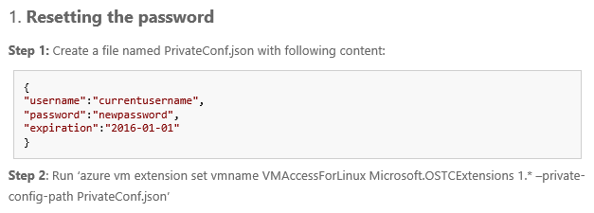
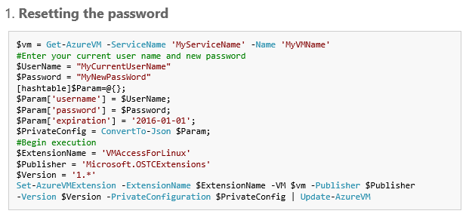
VMAccess Extension
The VMAccess extension enables you to reset the password, SSH key, or the SSH configurations, so you can regain access to your VM. You can also add a new user with password or SSH key, or delete a user using this extension.
Resetting the password
Resetting the SSH key
Resetting the password and the SSH key
Creating a new sudo user account
Resetting SSH configuration
Removing an existing user

Slide 34
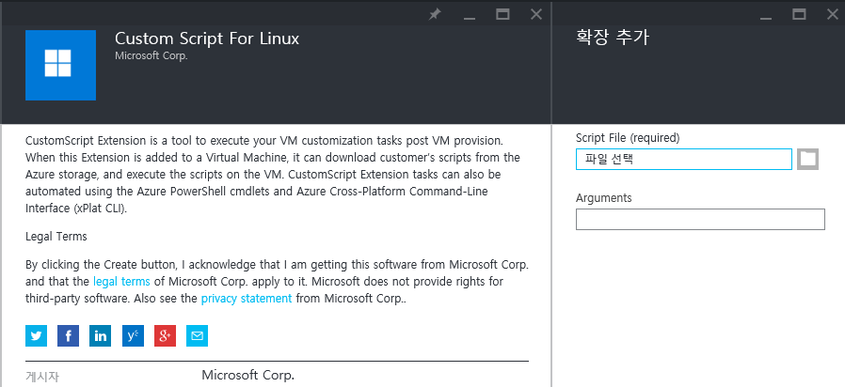
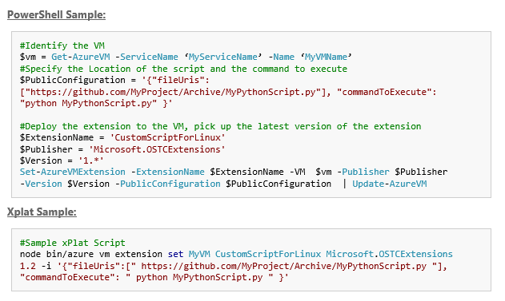
CustomScript Extension
Cloud-init enables you to inject a script or metadata into an Azure Linux VM during provision time. CustomScript extension provides even more power for customizing your VM, it can run on any Azure supported Linux VM.
Supports scripts in Azure Storage or GitHub with your parameters, or your inline scripts
CustomScript extension supports scripts written in any scripting language for Linux (Python, Linux shell scripts etc.), as long as the correspondent script interpreter is installed on your VM.
Can run your scripts any time after the provision.
Using Azure PowerShell Cmdlets, xPlat scripts or Azure Management Portal.
Can support multiple scripts or files with your scripts
Can run once or multiple times
Results of your scripts can be retrieved.
http://azure.microsoft.com/blog/2014/08/20/automate-linux-vm-customization-tasks-using-customscript-extension/

Slide 35
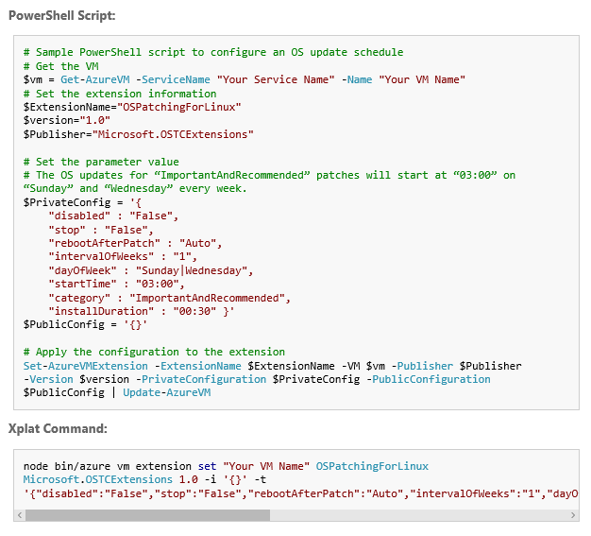
OSPatching Extension
Azure VM OSPatching extension for Linux enables the Azure VM administrators to automate the VM OS updates with the customized configurations.
Parameter | Description | Value Type | Default Value
intervalOfWeeks | The update frequency (in weeks) | Integer. Starting from 1.e.g. “intervalOfWeeks” : “1” | “1”
dayOfWeek | The patching date (of the week)You can specify multiple days in a week. | String. Enumeration of “Sunday”, “Monday”, “Tuesday”, “Wednesday”, “Thursday”, “Friday”, “Saturday”, Everyday (Use “|” to separate multiple values).e.g. “dayOfWeek” : “Sunday|Wednesday” | “Everyday”
startTime | Start time of patching | String. In the format of “hr:min”e.g. “startTime” : “03:00″ , with hour ranging from 0 to 23. More notes below. .¹ | Empty string(One-off mode)
installDuration | The allowed total time for installation | String. In the format of “hr:mins”e.g. “installDuration” : “00:30″. More notes below.² | “01:00”
category | Type of patches to install | String. Enumeration of “Important” and “ImportantAndRecommended”.e.g. “category” : “ImportantAndRecommended” | “ImportantAndRecommended”
rebootAfterPatch | The reboot behavior after patching | String. Enumeration of “Required” (always reboot), “NotRequired” (never reboot) and “ Auto”(use the VM’s current reboot mechanism).e.g. “rebootAfterPatch” : “Auto | “Auto”
disabled | Flag to disable this extension, | String. “True” or “False”e.g. “disabled” : “False” | “False”
stop | Flag to cancel the OS update process | String. “True” or “False”e.g. “stop” : “False” | “False”
http://azure.microsoft.com/blog/2014/10/23/automate-linux-vm-os-updates-using-ospatching-extension/

Slide 36
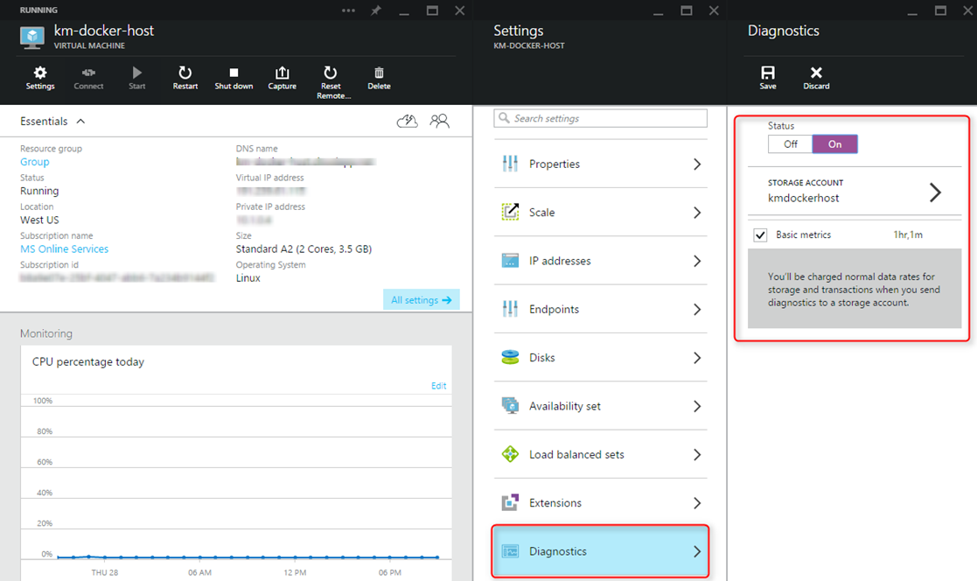
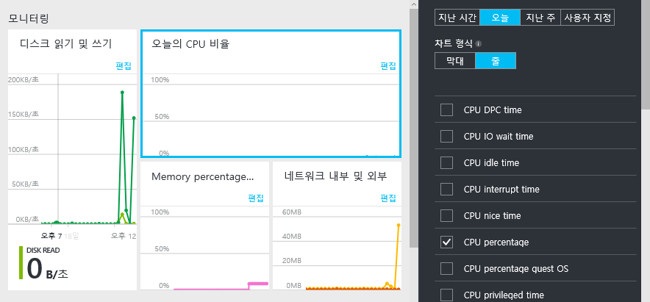
Infrastructure Monitoring and Diagnostics
The Linux diagnostic extension helps user to monitor the Linux VMs running on Azure, with following functionalities:
Collects and uploads Linux VM's system performance, diagnostic and syslog data to user’s storage table.
All Linux Rsyslog loggings, including system, security and application logs.
All system data specified in this doc.
User specified log files.
CPU DPC time
CPU IO wait time
CPU idle time
CPU interrupt time
CPU nice time
CPU percentage
CPU percentage guest OS
CPU privileged time
CPU user time
Disk queue length
Disk read
Disk read guest OS
Disk read time
Disk reads
Disk total bytes
Disk transfer time
Disk transfers
Disk write
Disk write guest OS
Disk write time
Disk writes
Mem. percent available
Mem. used by cache
Memory available
Memory percentage
Memory used
Network In
Network Out
Network collisions
Network in guest OS
Network out guest OS
Network total bytes
Packets received
Packets received errors
Packets sent
Packets sent errors
Page reads
Page writes
Pages
Swap available
Swap percent available
Swap percent used
Swap used
http://azure.microsoft.com/blog/2015/06/09/azure-linux-vm-infrastructure-monitoring-and-diagnostics-2/

Slide 37
Operational Management Suite

Slide 38
Operations Management Suite Simplified guest and workload management anywhere
Many more to come….
Operations
Management
Suite
Deliver IT insights
Log analytics
Fast integrated search
Custom dashboard
Champion security
Malware assessment
Security posture
System update assessment
Improve operational efficiency
Workflow & DSC
Graphical & PowerShell authoring
Increase availability
Backup
Disaster recovery
Migration
Workload mobility
MICROSOFT CONFIDENTIAL – INTERNAL ONLY
Notes:
Microsoft Operations Management Suite (OMS) manages and protects guests and workloads across Azure, AWS, Windows Server, Linux, VMware, and OpenStack at a lower cost than competitive solutions.

Slide 39
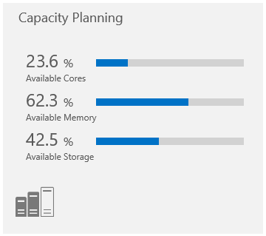
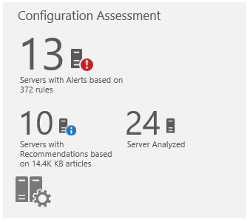
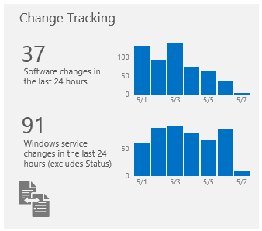
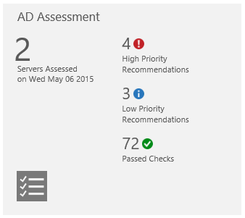
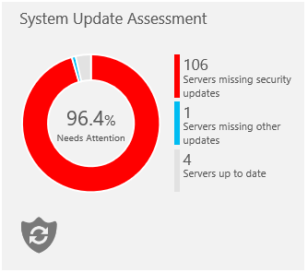
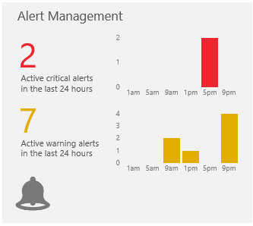
Deliver IT insights
With Log Analytics
Combine and correlate any machine data from multiple sources with
Integrated search and
Custom dashboards
Faster investigation and resolution of operational issues through various solution packs including:
Alert management,
Active Directory assessment,
Capacity planning,
Change tracking,
System update assessment, etc.,
Notes:
Log management across physical, virtual, and cloud infrastructure
Separate the signal from the noise with powerful log management tools
Collect and search across multiple sources from multiple systems in a single Big Data store
Easily identify the root cause of operational issues
Capacity planning and deep visibility into your datacenter and across premises
Pinpoint capacity shortages and investigate “what-if” scenarios
Identify stale and over-allocated virtual machines
Plan your future compute and storage needs for your infrastructure
Faster investigation and resolution of operational issues with deep insights
Offer pre-built rules and algorithms that perform initial analysis
Accelerate the time to first insight

Slide 40
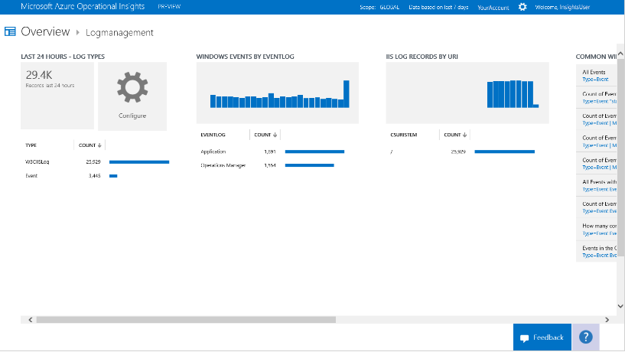
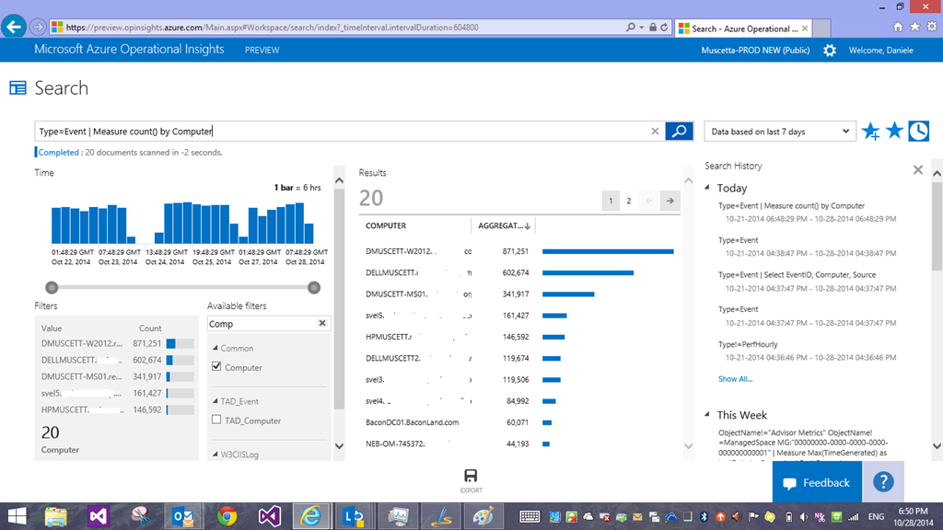
Azure Operational Insight
Log Management
Data collected
Windows Event logs
Makes it easy to capture, index, search, analyze and correlate logs in a searchable big data store
Search capability – build and save complex queries (examples below)
Type=Event EventLog="Operations Manager" EventID:[2100..2199]
Type=Event EventID=1234 | Sort Computer asc,TimeGenerated desc
Type=Event | Measure count() by Computer
Type=ConfigurationChange | Measure Max(TimeGenerated) by Computer
Type=PerfHourly InstanceName:_Total ((ObjectName:Processor AND CounterName:"% Processor Time") OR (ObjectName="LogicalDisk" AND CounterName="% Free Space")) AND TimeGenerated>NOW-4HOURS AND (Computer=”SERVER1.contoso.com” OR Computer=”SERVER2.contoso.com” OR Computer=”SERVER3.contoso.com”) | Measure Avg(SampleValue) by CounterName
Notes:
Slide title: Anti-virus & anti-malware
Slide objective: Describe the benefits and key components of anti-virus & anti-malware protection.
Slide script:
Antimalware helps protect the platform from viruses, malware, spyware, and other malicious software and customers can enable antimalware for their applications and infrastructure in Azure.
AZURE:
Performs monitoring & alerting of security events for the platform. Azure also scans all software components (including OS) deployed to Azure for malware as part of our internal build and deployment.
Enables real time protection, on-demand scanning, and monitoring via Microsoft Antimalware for Cloud Services and Virtual Machines
CUSTOMER:
Configures Microsoft Antimalware or an AV/AM solution from a partner
Extracts events to SIEM
Monitors alerts & reports
Responds to incidents
For added assurance, VMs can be routinely reimaged to clean out intrusions that may have gone undetected.

Slide 41
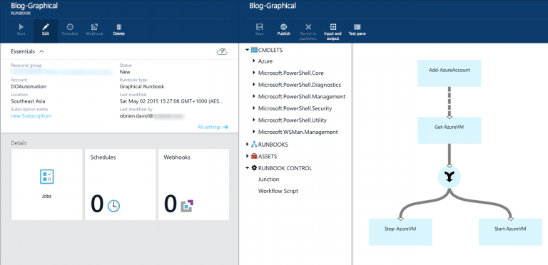
Improve operational efficiency
With Automation
Works across clouds, on-premises systems and PowerShell DSC nodes
Graphical workflow-authoring tool
Integrated workflow and runbook management
Ready-to-use runbooks from a centralized library
Notes:
Creation, monitoring, management, and deployment of resources in hybrid environments
Securely manage and monitor tasks using a runbook across on-premises and cloud environments
Automate repetitive tasks with Azure Automation to start runbooks daily, hourly, or at a single point in the future
Ready-to-use automation sample, utility, and scenario runbooks
Import sample runbooks from Runbook Gallery or create your own
Leverage the work of the community to build runbooks quickly
Runbook monitoring with easy-to-read dashboard charts and log records
Use the chart, jobs table, and quick-glance section of the automation dashboard
Monitor the state of your runbooks and troubleshoot your runbook jobs

Slide 42
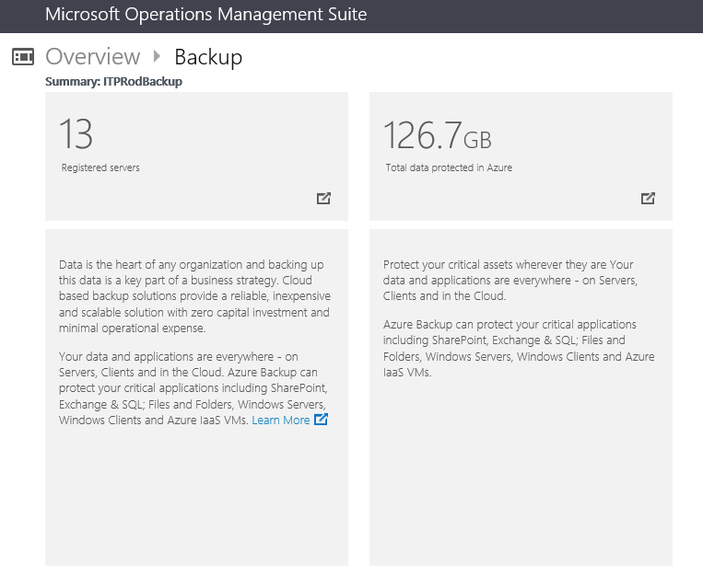
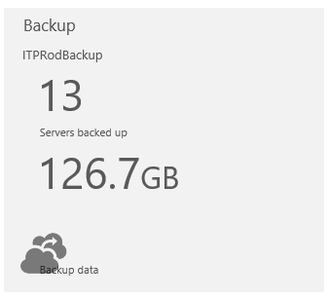
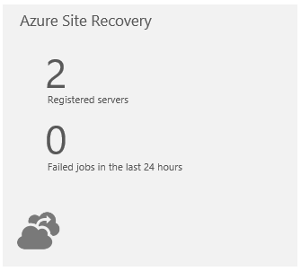
Increase availability
With BCDR and workload mobility
Automated virtual machine replication
Protect your critical systems and applications
Customize recovery plans with easy-to-manage recovery points
Migrate from physical and virtual to Azure
Access new scenarios including cloud bursting and dev/test
Notes:
Ability to define recovery plans and easy-to-manage recovery points
Help eliminate the chance of data loss in case of disaster, with better recovery points management
Meet the business requirements of cloud protection with customized recovery plans
Maximum uptime with resource health assessment
Get continuous health monitoring of protected instances, remotely or on local servers
Unified solution for protecting data on-premises and in the cloud
Protect your critical systems and applications, including Microsoft SharePoint, Exchange, SQL Server, files and folders, Windows servers, Windows clients, and Azure IaaS virtual machines

Slide 43
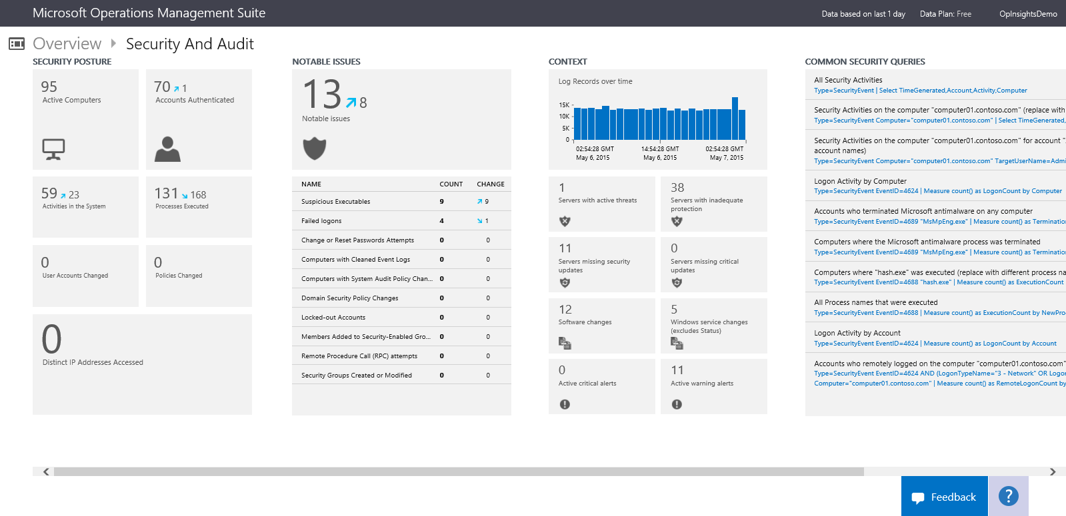
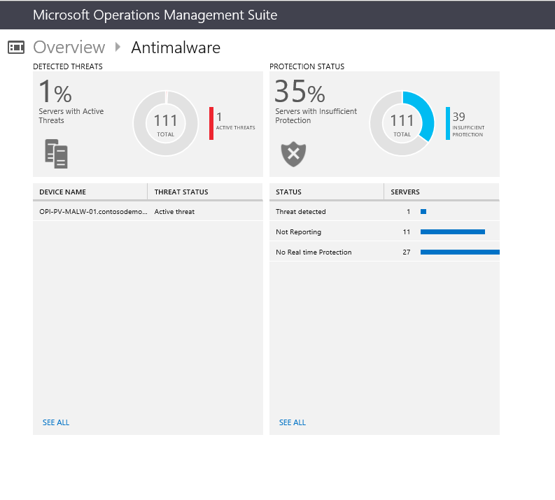
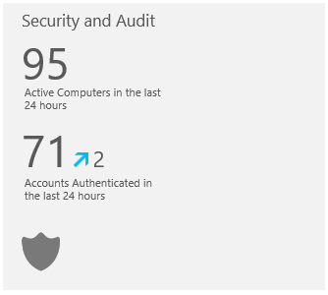
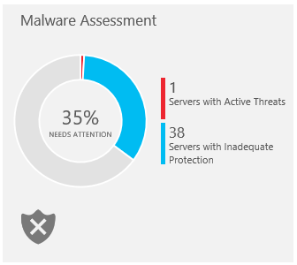
Champion security
With events analysis and assessments
Collect security related events and perform forensic and audit analysis
Comprehensive updates assessment across datacenters and public clouds
Detection of breaches and threats with malware assessment
Notes:
Comprehensive updates assessment across datacenters and public clouds
Identify missing system updates across all servers
Enable cloud-based patch management for all your environments
Know which of your servers have the latest updates and which need them
Detection of breaches and threats with malware assessment
Quickly assess servers that are infected by malware
Assess the risk and health of Active Directory and SQL Server
Use built-in search queries for issues that require your attention
Compliance and certifications from industry standards
Ensure that your IT infrastructure meets compliance standards
Collect security logs
Perform audits at regular intervals

Slide 44
Automation

Slide 45
The Problem
“Keeping the 1000s of servers running my services configured correctly is incredibly complicated and error-prone.”

Slide 46
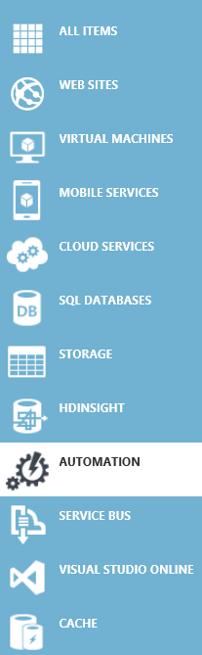
Azure Automation Capabilities
Runbook Authoring in Azure:
Create runbooks to automate all aspects of cloud management in cloud based Monaco editor.
Highly Available Engine:
Support requirements for scale and H/A.
Built on PowerShell Workflow. Isolation for runbook jobs.
Integration into other systems:
Import existing or create new PS modules and runbooks for Azure services or to connect into 3rd party systems.
Azure
Automation
Purge stale logs from SQL
Patch Azure VMs without downtime
Remediate alert on a service
Staged deployment of a service
Monitoring
Systems
Change Control Systems
Anything ☺

Slide 47
Built on PowerShell Workflow
Centralized store
Highly Available
PowerShell Workflow
Use Windows PowerShell syntax
Running a single task to manage complex, end-to-end processes
Automated failure recovery
Connection and activity retries
Multi-device management
Historical Analysis
View runbook used for all jobs
Reporting through Excel PowerPivot for ROI
Historical view of runbook jobs
SQL Server clustering / always on
Odata Web service to submit / retrieve status
Runbook servers to process jobs
Scheduling
Runbooks (draft / published versioning)
Modules
Global connection for runbooks
Global variable
Credentials / certificates
PowerShell Workflow
Centralized store
Microsoft Azure Automation
Highly Available
Historical Analysis
Managing SSH-Enabled Linux Hosts with Azure Automation
http://azure.microsoft.com/blog/2015/07/14/managing-ssh-enabled-linux-hosts-with-azure-automation/

Slide 48
Configuration and Continuous Deployment
Intent | Environment Configuration (Dev -> Test -> Production) | $SiteName = “TestWebApp” $SitePath = “d:\inetpub\testsite” Servers = 3 …
 | Structural Configuration | Website IIS { Ensure = "Present“ Name = $SiteName Path = $SitePath } …
Make It So | Idempotent Automation | foreach -parallel ($featureName in $Name) { $feature = Get-WindowsFeature -Name $featureName if(($Ensure -eq "Present") -and (!$feature.Installed)) { Install-WindowsFeature -Name $featureName } …. } …

Slide 49
DSC Availability
Ships in Windows Server 2012 R2 and Windows 8.1
Windows Management Framework (WMF) 4.0
For Windows Server 2012, Windows Server 2008 R2 & Windows 7
Windows support & cadence
WMF 5.0 previews
Windows 7, Windows 8.1, Windows Server 2008 R2, Windows Server 2012, Windows Server 2012 R2 – As of April 2015 Preview
Fix forward and faster cadence
ResKit: Online availability of “x” DSC resources
Ongoing Development: Open Source development of resources
GitHub repo: PowerShell/DSCResources

